Slide 1

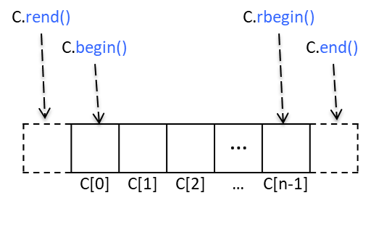
CPSC 131 – Data Structures
Iterators
Professor T. L. Bettens
Spring 2023

Slide 2
Containers and Iterators
Container is an abstract data structure that stores a collection of elements
Iterator abstracts the process of looping through the collection of elements
Let C be a container and p be an iterator over C
for (p = C.begin(); p != C.end(); ++p)
{
p->do_something()
}

Slide 3
Iterator Categories
Josuttis 9.2
Iterators are objects:
that can iterate over elements of a sequence via a common interface
adapted from ordinary pointers
Anything that behaves like an iterator is-a iterator
ordinary pointer is-a iterator
However, iterators have even more abilities!

Slide 4
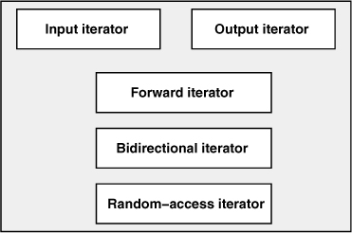
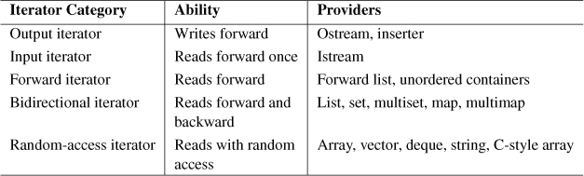
Iterator Categories
Josuttis 9.2
Inheritance
Hierarchy
Continuous iterator
Added in C++20

Slide 5
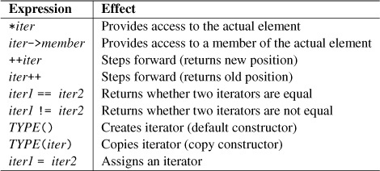
Iterator Capability
Josuttis 9.2
Forward Iterator
A Forward Iterator can only go forward one node at a time

Slide 6

Iterator Capability
Josuttis 9.2
Bidirectional Iterator
Everything a Forward Iterator can do, plus
A Bidirectional Iterator is-a Forward Iterator, plus more

Slide 7
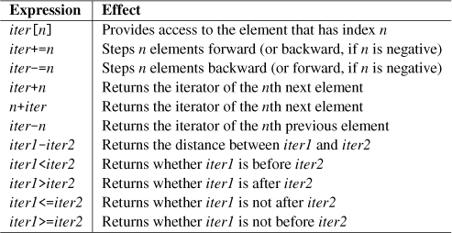
Iterator Capability
Josuttis 9.2
Random-Access Iterator
Everything a Bidirectional can do, plus
A Random-Access Iterator is-a Bidirectional Iterator, plus more

Slide 8
STL Containers and Iterators
std::list<T>
 |  |  |  |  |  |  |  | …
C.rend()
C.rbegin()
C.begin()
C.end()
C.rend()
C.rbegin()
 |  |  |  | …
 | C[0] | C[1] | C[2] | … | C[n-1]
std::vector<T> std::array <T, N>
C.begin()
C.end()
C.before_begin()
 |  |  |  |  |  |  |  | …
std::forward_list<T>
Each STL container, call it C, has an associated class Iterator
begin(), rbegin(): returns an iterator to the first element
end(), rend(): returns an iterator to an imaginary position just after the last element
An iterator behaves like a pointer to an element
*p: returns the element referenced by this iterator; access current element
++p or p++: advances to the next element
Most STL containers provide the ability to move backwards
--p or p--: moves to the previous element
Not a pointer-to-Node

Slide 9
Iterating through Containers
Let C be a container and p be an iterator over C
for (p = C.begin(); p != C.end(); ++p)
{
p->do_something()
}
STL Vector example
#include <vector>
int main()
{
std::vector<int> C = {-2, 5, -7, 0, 10, 100};
int sum = 0;
for (vector<int>::iterator p=C.begin(); p != C.end(); ++p)
{
sum += *p;
}
}
STL Single Linked List example
#include <forward_list>
int main()
{
std::forward_list<int> C = {-2, 5, -7, 0, 10, 100};
int sum = 0;
for (forward_list<int>::iterator p=C.begin(); p != C.end(); ++p)
{
sum += *p;
}
}
Very similar!

Slide 10
Iterating through Containers
Let C be a container and p be an iterator over C
for (p = C.begin(); p != C.end(); ++p)
{
p->do_something()
}
STL Vector example
#include <vector>
int main()
{
std::vector<int> C = {-2, 5, -7, 0, 10, 100};
int sum = 0;
for (auto & p=C.begin(); p != C.end(); ++p)
{
sum += *p;
}
}
STL Single Linked List example
#include <forward_list>
int main()
{
std::forward_list<int> C = {-2, 5, -7, 0, 10, 100};
int sum = 0;
for (auto & p=C.begin(); p != C.end(); ++p)
{
sum += *p;
}
}
Identical!!

Slide 11
Iterating through Containers
Let C be a container and element be an item within C
for (const auto & element : C)
{
element.do_something()
}
STL Vector example
#include <vector>
int main()
{
std::vector<int> C = {-2, 5, -7, 0, 10, 100};
int sum = 0;
for (const auto & element : C)
{
sum += element;
}
}
STL Single Linked List example
#include <forward_list>
int main()
{
std::forward_list<int> C = {-2, 5, -7, 0, 10, 100};
int sum = 0;
for (const auto & element : C)
{
sum += element;
}
}
Identical!!

Slide 12
STL Iterators in C++
Each STL container type C supports iterators:
C::iterator – read/write iterator type
C::const_iterator – read-only iterator type
C.begin(), C.end() – return start and end iterators, respectively
C.rbegin(), C.rend() – return start and end reverse iterators, respectively
NOT FOR std::forward_list
Various notions of iterator:
(standard) iterator: allows read-write access to elements
const iterator: provides read-only access to elements
forward iterator: supports ++p
bidirectional iterator: supports both ++p and –p
random access iterator: supports both p+n, p-n (vectors and arrays)

Slide 13
Auxiliary Iterator Functions
Josuttis 9.3
advance(), next(), prev(), distance()
gives all iterators some abilities usually provided only for random-access iterators
to step more than one element forward (or backward)
to process the difference between iterators

Slide 14
advance()
Josuttis 9.3
void advance (InputIterator& pos, Dist n)
https://en.cppreference.com/w/cpp/iterator/advance
Modifies the iterator pos
Increments (or decrements) pos n times
lets the iterator step forward (or backward) more than one element
Still an O(n) operation for lists and O(1) for vectors and arrays

Slide 15
next() and prev()
Josuttis 9.3
ForwardIterator next (ForwardIterator pos, Dist n=1)
BidirectionalIterator prev (BidirectionalIterator pos, Dist n=1)
https://en.cppreference.com/w/cpp/iterator/next
https://en.cppreference.com/w/cpp/iterator/prev
Returns the position pos would have if moved forward (next()) or backwards (prev()) n positions.
Does not modify the iterator pos
next() works with forward, bidirectional, or random-access iterator
prev() works with bidirectional, or random-access iterators, but not forward iterators

Slide 16
distance()
Josuttis 9.3
Dist distance (InputIterator pos1, InputIterator pos2)
https://en.cppreference.com/w/cpp/iterator/distance
Returns the difference between two iterators
Still an O(n) operation for lists and O(1) for vectors and arrays
Consider:
std::distance( c.begin(), c.end() ) == c.size()
std::distance( c.end(), c.begin() ) is a logic error

Slide 17
Example of Iterator Useage
DoublyLinkedList<string> list;
DoublyLinkedList<string>::iterator itor; //iterator is a nested type
// Example 1:
itor = list.begin();
while (itor != list.end())
{
std::cout << *itor << std::endl;
++itor;
}
// Example 2: (equivalent, but with a traditional for loop)
for (itor = list.begin(); itor != list.end(); ++itor)
{
cout << *itor << endl;
}

Slide 18
Example of Iterator Use
Display every other element of a doubly linked list in reverse using reverse iterators.
int main()
{
std::list<char> letters = {'A', 'B', 'C', 'D’, 'E', 'F', 'G'};
for( auto p = letters.rbegin(); p != letters.rend(); ++p)
{
std::cout << *p << '\n';
if( std::next(p) != letters.rend() ) ++p; //be careful not to
} //over increment
}

Slide 19
Example of Iterator Use
Given the following definition, which element is displayed by the expression listed on the left?
std::list<char> col = {'A', 'B', 'C', 'D', 'E', 'F', 'G'};
std::cout << *( col.begin() + 1 ) << '\n';
std::cout << *( ++col.begin() ) << '\n';
std::cout << col.rbegin()[4] << '\n';
std::cout << *( col.crend() ) << '\n';
std::cout << *( col.before_begin() ) << '\n';
std::cout << col[std::distance( col.begin() + 1, col.end() - 3 )] << '\n';
std::cout << *( std::next( col.begin(), 3 ) ) << '\n';
auto p = col.end(); std::advance( p, -2 ); std::cout << *p << '\n';
auto p = col.rend(); std::advance( p, -5 ); std::cout << *p << '\n';
Syntax Error
B
Syntax Error
Logic Error
Syntax Error
Syntax Error
D
Logic Error if implemented as a null terminated list
F
Logic Error if implemented as a null terminated list
E

Slide 20
Example of Iterator Use
Given the following definition, which element is displayed by the expression listed on the left?
std::vector<char> col = {'A', 'B', 'C', 'D', 'E', 'F', 'G'};
std::cout << *( col.begin() + 1 ) << '\n';
std::cout << *( ++col.begin() ) << '\n';
std::cout << col.rbegin()[4] << '\n';
std::cout << *( col.crend() ) << '\n';
std::cout << *( col.before_begin() ) << '\n';
std::cout << col[std::distance( col.begin() + 1, col.end() - 3 )] << '\n';
std::cout << *( std::next( col.begin(), 3 ) ) << '\n';
auto p = col.end(); std::advance( p, -2 ); std::cout << *p << '\n';
auto p = col.rend(); std::advance( p, -5 ); std::cout << *p << '\n';
B
B
C
Logic Error
Syntax Error
D
D
F
E

Slide 21
Iterator Interface
template<typename T1> template<typename T2>
class DoublyLinkedList<T1>::Iterator_type
{
friend class DoublyLinkedList<T1>;
public:
// Iterator Type Traits - Boilerplate stuff so the iterator can be used with the rest of the standard library
using iterator_category = std::bidirectional_iterator_tag;
using value_type = T2;
using difference_type = std::ptrdiff_t;
using pointer = std::conditional_t< std::is_const_v<T2>, T2 const *, T2 *>;
using reference = std::conditional_t< std::is_const_v<T2>, T2 const &, T2 &>;
// Compiler synthesized constructors and destructor are fine, just what we want (shallow copies, no ownership) but needed to
// explicitly say that because there is also a user defined constructor
Iterator_type ( ) = delete; // Default constructed Iterator_type not allowed
Iterator_type ( iterator const & other ); // Copy constructor when T is non-const, Conversion constructor when T is const
// Pre and post Increment operators move the position to the next node in the list
Iterator_type & operator++(); // advance the iterator one node (pre -increment)
Iterator_type operator++( int ); // advance the iterator one node (post-increment)
// Pre and post Decrement operators move the position to the previous node in the list
Iterator_type & operator--(); // retreat the iterator one node (pre -decrement)
Iterator_type operator--( int ); // retreat the iterator one node (post-decrement)
// Dereferencing and member access operators provide access to data. The iterator itself can be constant or non-constant, but,
// by definition, points to a non-constant linked list.
reference operator* () const;
pointer operator->() const;
// Equality operators
bool operator==( Iterator_type const & rhs ) const; // Symmetrically compares all const & non-const iterator combinations,
// with the help of the Conversion constructor above
private:
// Member attributes
Node * _nodePtr = nullptr;
// Helper functions
Iterator_type( Node * position ); // Implicit conversion constructor from pointer-to-Node to iterator-to-Node
}; // DoublyLinkedList<T>::Iterator_type
Iterator has-a private (hidden) pointer-to-node

Slide 22
operator++
operator--
// operator++ pre-increment
template<typename T1> template<typename T2>
typename DoublyLinkedList<T1>::template Iterator_type<T2> & DoublyLinkedList<T1>::Iterator_type<T2>::operator++()
{
_nodePtr = _nodePtr->_next;
return *this;
}
// operator++ post-increment
template<typename T1> template<typename T2>
typename DoublyLinkedList<T1>::template Iterator_type<T2> DoublyLinkedList<T1>::Iterator_type<T2>::operator++( int )
{
auto temp{ *this };
operator++(); // Delegate to pre-increment leveraging error checking
return temp;
}
Notice how post-increment creates and destroys a temp object, but the pre-increment doesn’t
// operator-- pre-decrement
template<typename T1> template<typename T2>
typename DoublyLinkedList<T1>::template Iterator_type<T2> & DoublyLinkedList<T1>::Iterator_type<T2>::operator--()
{
_nodePtr = _nodePtr->_prev;
return *this;
}
// operator-- post-decrement
template<typename T1> template<typename T2>
typename DoublyLinkedList<T1>::template Iterator_type<T2> DoublyLinkedList<T1>::Iterator_type<T2>::operator--( int )
{
auto temp( *this );
operator--(); // Delegate to pre-decrement leveraging error checking
return temp;
}

Slide 23
operator*
// operator*
template<typename T1> template<typename T2> typename DoublyLinkedList<T1>::template
Iterator_type<T2>::reference DoublyLinkedList<T1>::Iterator_type<T2>::operator*() const
{
return _nodePtr->_data;
}
operator->
// operator->
template<typename T1> template<typename T2> typename DoublyLinkedList<T1>::template Iterator_type<T2>::pointer DoublyLinkedList<T1>::Iterator_type<T2>::operator->() const
{
return &(_nodePtr->_data);
}
Return a reference to the Node’s data
(not the Node itself)
Return a pointer to the Node’s data
(not the Node itself)

Slide 24
operator==
// operator==
template<typename T1> template<typename T2>
bool DoublyLinkedList<T1>::Iterator_type<T2>::operator==( Iterator_type const & rhs ) const
{ return _nodePtr == rhs._nodePtr; }
Two iterators are equal if they point to the same Node

